Slide 2
DISCLAIMER
This slide deck in its original and unaltered format is for educational purposes and is current as of June 2023. All materials contained herein reflect the views of the faculty, and not those of AXIS Medical Education, the CME provider, or the commercial supporter. Participants have an implied responsibility to use the newly acquired information to enhance patient outcomes and their own professional development. The information presented in this activity is not meant to serve as a guideline for patient management. Any procedures, medications, or other courses of diagnosis or treatment discussed or suggested in this activity should not be used by clinicians without evaluation of their patients’ conditions and possible contraindications on dangers in use, review of any applicable manufacturer’s product information, and comparison with recommendations of other authorities.

Slide 3
DISCLOSURE OF UNLABELED USE
This activity may contain discussion of published and/or investigational uses of agents that are not indicated by the FDA. The planners of this activity do not recommend the use of any agent outside of the labeled indications.
The opinions expressed in the activity are those of the faculty and do not necessarily represent the views of the planners. Please refer to the official prescribing information for each product for discussion of approved indications, contraindications, and warnings.
USAGE RIGHTS
This slide deck is provided for educational purposes and individual slides may be
used for personal, non-commercial presentations only if the content and references
remain unchanged. No part of this slide deck may be published in print or
electronically as a promotional or certified educational activity without prior written
permission from AXIS. Additional terms may apply. See Terms of Service on
www.axismeded.com for details.

Slide 4
Disclosure of Conflicts of Interest
Rami Komrokji, MD has reported reported a financial interest/relationship or affiliation in the form of: Advisor; AbbVie, Bristol-Myers Squibb Company, CTI BioPharma Corporation, Geron, Jazz Pharmaceuticals, Novartis Pharmaceuticals Corporation, Pharma Essentia, Servier, Taiho Pharmaceutical Co., Ltd., Rigel Pharmaceuticals. Speaker; AbbVie, CTI BioPharma Corporation, Jazz Pharmaceuticals, Pharma Essentia, Servier. Research grant; Bristol-Myers Squibb Company
Allan Platt, PA-C, MMSc, has no real or apparent conflicts of interest to report.
Paul P. Doghramji, MD has reported reported a financial interest/relationship or affiliation in the form of: Consultant: Eisai, Inc. and Idorsia Pharmaceuticals, Ltd. Speaker’s bureau member of: Eisai, Inc., Idorsia Pharmaceuticals, Ltd., Axiom Pharmaceuticals, Inc., Jazz Pharmaceuticals, and Abbvie. Stocks: Pfizer.
Notes:
Moderator
Paul P. Doghramji, MD, FAAFP
Senior Family Practice Physician
Collegeville Family Practice
Medical Director of Health Services
Ursinus College, Collegeville, Pennsylvania
Panelists
Rami Komrokji, MD
Vice Chair Malignant Hematology, Senior Member
Moffitt Cancer Center
Tampa, Florida
Allan Platt, PA-C, MMSc
Assistant Professor
Emory University School of Medicine
Physician Assistant Program
Atlanta, Georgia

Slide 5
Learning Objectives
Upon completion of this activity, participants should be better able to:
Identify patients with LR-MDS and anemia that is refractory to ESA therapy using a team-based approach
Analyze real-world data surrounding the prompt use of novel and emerging therapies for transfusion-dependent, ESA-refractory LR-MDS, including proper dose escalation
Attain transfusion independence in patients with transfusion-dependent, ESA-refractory LR-MDS by integrating novel therapies into treatment plans based on updated clinical data
Interpret emerging evidence in ESA-naive LR-MDS

Slide 6
Unmet Needs in LR-MDS
Diagnosis of Anemia and Referral to a Hematologist

Slide 7
Anemia in Adults
Presentation
Lab Workup
Approximately one-fifth of adults in primary care clinics are anemic
Patient history – Fatigue, weakness, dyspnea, palpitations, new angina, non-vertigo dizziness
Physical Exam – Pallor, tachypnea, tachycardia, orthostasis, jaundice
Lab – CBC with low Hb, Hct, RBC count
CBC with WBC differential
Peripheral blood smear
Reticulocyte count (corrected)
Comprehensive metabolic panel (CMP)
Urinalysis
Notes:
Gandhi SJ, Hagans I, Nathan K, Hunter K, Roy S. Prevalence, comorbidity and investigation of anemia in the primary care office. J Clin Med Res. 2017;9(12):970–980.

Slide 8
Lab Workup for Low Hb/Hct to Assess for BPH (Bleeding/Production/Hemolysis)
MCV <80 – Microcytic
Order Iron studies, HbELP, Lead Level CRP
Retic Production index <2 – Marrow Production Problem
Check MCV
MCV 80-100 – Normocytic
Order CRP, TSH, kidney, liver, and Pregnancy Test
Anemic - Lab
CBC, Retic, RBC morphology, CMP, Urinalysis
MCV >100 – Macrocytic
Order B12, RBC and serum Folate, MMA, Homocysteine
With low Platelets and/or low WBCs, refer to Hematology
Increased Indirect Bilirubin and low haptoglobin =
Hemolysis, Order Coombs/DAT, Heinz Body stain, HbELP
Retic Production Index >2 RBC Loss
Bleeding or Hemolysis
Bleeding

Slide 9
Workup for Microcytic Anemia TICS (Thalassemia, Iron deficiency, Chronic inflammation, Sideroblastic Anemia; Rule Out Lead Toxicity)
Iron studies is ferritin low?
Yes =
Iron deficiency
No, CRP or ESR elevated – inflammatory block
No, basophilic stippling, lead level elevated – chelation therapy
No, abnormal HbELP? Target cells?
Work up for chronic blood loss – GI, menses and replace iron
Diet
Yes = Thalassemia – refer to hematologist if severe
Do Hb DNA for alpha thal – refer to hematologist for bone marrow Bx

Slide 10
Workup for Normocytic Anemia “Normal Size”
Possible Acute GI or other bleed?
Retic takes 24-48 hours to rise
Check BUN/Creatinine/Liver, UA, CRP, Pregnancy test
BUN/Creatinine elevated or abnormal UA
TSH elevated = Hypothyroid
AST/ALT/AlkP – Liver disease
CRP elevated- inflammatory block
Pregnancy test +
Prenatal care
Pancytopenia
Work up for renal disease and low EPO
No - Repeat CBC, Retic in 2 week
Refer to hematologist for bone marrow Bx

Slide 11
Workup for Macrocytic Anemia
Serum B12
RBC/serum folate
B12 normal/folate normal - Order methylmalonic acid and homocysteine levels
B12 low/folate low = B12 deficiency or both
Methylmalonic acid elevated in early B12 deficiency
Consider liver disease, hypothyroid, HIV, drugs, toxins, low copper –
Refer for BM Bx
Homocysteine levels elevated in folate deficiency
Replace with oral, nasal or IM B12 and folate

Slide 12
Workup for Hemolytic Anemia Retic Production Index >2, high LDH, high indirect bilirubin, low haptoglobin
Coombs or DAT positive
No – Heinz bodies +
No – HbELP abnormal + hemoglobinopathy – SS, SC, SD, S beta thal
Yes
Immune attack
No – RBC Morphology+ schistocytes and low platelets in DIC, HIT, TTP, HELLP
Yes = G6PD deficiency, stop the drug or fava beans
Warm Antibody
IgG+ C3d +/-
Cold Antibody IgM
IgG- C3d+

Slide 13
Unmet Needs in LR-MDS
Utility of ESAs and Identification of ESA Failure
ESA, erythropoiesis-stimulating agents; LR-MDS, low-risk myelodysplastic syndrome.

Slide 14
Scope of the Problem
MDS is the most common myeloid neoplasm and one of the most common causes of anemia in elderly patients
Lower-risk MDS constitutes almost half of MDS cases
One-third of patients will progress to higher-risk/AML
Lower-risk MDS remains a major source of morbidity and mortality, primarily due to cytopenia complications
Majority of patients are anemic, and more than half become RBC TD over time
Isolated thrombocytopenia and/or neutropenia are rare but concomitant cytopenia with anemia is common
Limited treatment options and unmet need for large number of patients
All currently available therapies have response rates of approximately 30% and response durations of 1-2 years
Notes:
Volpe VO, Garcia-Manero G, Komrokji RS. SOHO state of the art updates and next questions: treatment of lower risk myelodysplastic syndromes. Clin Lymphoma Myeloma Leuk. 2023;23(3):168-177.

Slide 15
Results: Disease Progression and Causes of Death
Patientsª with and without a ≥5% increase in bone marrow blast count during follow-up
Reasons attributed to patient deaths (n = 213)
<5% increase
≥5% increase
Not evaluable^{b}
Disease related
Cardiovascular disease
Respiratory failure
Other/unknown^{c}
0–2%
3–4%
5–10%
All baseline blast counts
All baseline blast counts
Patients with baseline and follow-up bone marrow blast counts (n = 144)
Total patients
(N = 531)
Baseline blast category
Notes:
Treatment patterns and outcomes of patients with lower-risk myelodysplastic syndromes in the CONNECT ® Myeloid Disease Registry. Komrokji RS, George TI, Erba HP, Scott BL, Grinblatt DL, Maciejewski JP, Roboz GJ, Savona MR, Garcia-Manero G, DeGutis IS, Kiselev P, Yu E, Makinde AY, Sekeres MA. Blood. 2021;138(suppl 1):3686.

Slide 16
Results: Initial Treatments by Baseline Anemia
Patient characteristics from the Connect® Myeloid Disease Registry:
531 patients with LR-MDS (mean age 74.0 years, 66.5% male) were enrolled
215 patients (40.6%) were classified as low-risk; 314 (59.2%) were classified as Int-1 risk by IPSS
No/mild anemia
(n = 30)
Moderate anemia
(n = 104)
Severe anemia
(n = 58)
Results:
330 (62.1%) patients received no treatment at baseline, including:
163 (49.4%) with no/mild anemia
122 (37.0%) with moderate anemia
45 (13.6%) with severe anemia
Of the 330 patients, 38 (11.5%) died without receiving any treatment
Safety results:
Death occurred in 213 (40.1%) patients
Approximately half of patient deaths were MDS-related
HMA ESA IMiD
Notes:
Treatment patterns and outcomes of patients with lower-risk myelodysplastic syndromes in the CONNECT ® Myeloid Disease Registry. Komrokji RS, George TI, Erba HP, Scott BL, Grinblatt DL, Maciejewski JP, Roboz GJ, Savona MR, Garcia-Manero G, DeGutis IS, Kiselev P, Yu E, Makinde AY, Sekeres MA. Blood. 2021;138(suppl 1):3686.

Slide 17
Outcome after ESA Failure
French, Spanish, Italian, Düsseldorf, Munich, Greek and US registries
Median survival times after ESA failure:
Primary refractory disease: 52.2 months
Relapsed disease: 60.4 months
(P = 0.12)
Of the 1,147 patients experiencing primary or secondary ESA failure, 450 (39%) received a second-line treatment other than RBC transfusions
Excluded
MDS with del(5q) and CMML
Progression to higher-risk IPSS score at loss of response to ESAs
Patients with lower-risk (by IPSS) MDS receiving ESA treatment with data on outcome (N = 1,698)
GFM trial; LEN plus EPO
GFM trial; AZA plus EPO
Persisting response (n = 551; 32.5%)
Relapse (n = 494; 29%)
Primary resistance (n = 653; 38.5%)
Response rate to ESAs, 61.5%
Second-line treatment (n = 450)
HMAs (n = 194)
LEN (n = 148)
MISC (n = 805)
RBC transfusion (n = 697)
Other (n = 108)
Notes:
Park S, Hamel J-F, Toma A, et al. Outcome of lower-risk patients with myelodysplastic syndromes without 5q deletion after failure of erythropoiesis-stimulating agents. J Clin Oncol. 2017;35(14):1591-1597.

Slide 18
How Do I Manage LR-MDS in 2023
Anemia
Allogeneic stem cell transplant may be considered after standard therapy failure or in younger patients with higher-risk disease features
Iron chelation should be considered in patients with evidence of iron overload
EPO<200mU/mL <2U RBC/mo
Del(5q) Iso- or +1
Isolated Thrombocytopenia
Isolated neutropenia
ESA
TPO+
IDH MT
IDH -
Del(5q)
Lenalidomide
≤60 years or hypoplastic MDS
IST
Non-del(5q)
MDS-RS
HMA 3 or 5 day
IST
Luspatercept
≤60 years or hypoplastic MDS
Isolated anemia
LEN +/- EPO
HMA 3 or 5 day
Notes:
Volpe VO, Garcia-Manero G, Komrokji RS. SOHO state of the art updates and next questions: treatment of lower risk myelodysplastic syndromes. Clin Lymphoma Myeloma Leuk. 2023;23(3):168-177.

Slide 19
Late-Breaking Data: What’s New and How Can I Use It?
Luspatercept for the Management of ESA-refractory LR-MDS

Slide 20
Luspatercept
Modified extracellular domain of ActRIIB
Human IgG1 Fc domain
Luspatercept
ActRIIB/IgG1 Fc recombinant fusion protein
First-in-class erythroid maturation agent inhibits abnormal SMAD2/3 signaling by neutralizing select TGF-β superfamily ligands and improves late-stage erythropoiesis in MDS models^{1,2}
Phase II study in patients with Low- or Intermediate-1-risk MDS, luspatercept yielded high frequency of transfusion reduction or RBC-TI in patients with MDS-RS versus other subtypes²
ActRIIB
TGF-β
superfamily ligand
Cytoplasm
P
Smad2/3
Nucleus
Complex
Erythroid maturation
Notes:
Fenaux P, Kiladjian JJ, Platzbecker U. Luspatercept for the treatment of anemia in myelodysplastic syndromes and primary myelofibrosis. Blood. 2019;133(8):790-794.
Suragani RNVS, Cadena SM, Cawley SM, et al. Transforming growth factor-β superfamily ligand trap ACE-536 corrects anemia by promoting late-stage erythropoiesis.
Nat Med. 2014;20:408-414.
Platzbecker U, Germing U, GötzeKS, et al. Luspatercept for the treatment of anaemia in patients with lower-risk myelodysplastic syndromes (PACE-MDS): a multicentre, open-label phase 2 dose-finding study with long-term extension study. Lancet Oncol. 2017;18(10):1338-1347.

Slide 21
MEDALIST Trial: Study Design A Randomized, Double-Blind, Placebo-Controlled, Phase 3 Study
Patient Population
MDS-RS (WHO): ≥15% RS or ≥5% with SF3B1 mutation
<5% blasts in bone marrow
No del(5q) MDS
IPSS-R Very Low-, Low-, or Intermediate-risk
Prior ESA response
Refractory, intolerant
ESA naive: EPO >200 U/L
Average RBC transfusion burden ≥2 units/8 weeks
No prior treatment with disease-modifying agents (eg, IMiDs, HMAs)
Luspatercept 1.0 mg/kg (s.c.) every 21 days
n = 153
Randomize 2:1
Dose titrated up to a maximum of 1.75 mg/kg
Placebo (s.c.) every 21 days
n = 76
Disease & Response Assessment week 25 & every 6 months Treatment discontinued for lack of clinical benefit or disease progression per IWG criteria or unacceptable toxicity; no crossover allowed
Subjects followed ≥3 years post final dose for AML progression, subsequent MDS treatment and overall survival
Notes:
Fenaux P, Platzbecker U, Mufti GJ, et al. Luspatercept in patients with lower-risk myelodysplastic syndromes. N Engl J Med. 2020;382(2):140-151.

Slide 22
MEDALIST: RBC Transfusion Independence
P < 0.001
P < 0.001
P < 0.001
Percentage of Patients
No. of Patients with Response (% [95% CI])
Luspatercept 58 (38 [30-46]) 43 (28 [21-36]) 51 (33 [26-41]) 29 (19 [13-26]) 43 (28 [21-36])
Placebo 10 (13 [6-23]) 6 (8 [3-16]) 9 (12 [6-21]) 3 (4 [1-11]) 5 (7 [2-15])
Notes:
Fenaux P, Platzbecker U, Mufti GJ, et al. Luspatercept in patients with lower-risk myelodysplastic syndromes. N Engl J Med. 2020;382(2):140-151.

Slide 23
MEDALIST: Adverse Events Occurring in ≥10% of Patients
Adverse event | Luspatercept (n = 153) n (%) |  | Placebo (n = 76) n (%)
 | Any grade | Grade 3 | Any grade | Grade 3
General disorder or administration site condition
Fatigue | 41 (27) | 7 (5) | 10 (13) | 2 (3)
Asthenia | 31 (20) | 4 (3) | 9 (12) | 0
Peripheral edema | 25 (16) | 0 | 13 (17) | 1 (1)
GI disorder
Diarrhea | 34 (22) | 0 | 7 (9) | 0
Nausea | 31 (20) | 1 (1) | 6 (8) | 0
Constipation | 17 (11) | 0 | 7 (9) | 0
Nervous system disorder
Dizziness | 30 (20) | 0 | 4 (5) | 0
Headache | 24 (16) | 1 (1) | 5 (7) | 0
Musculoskeletal or connective-tissue disorder
Back pain | 29 (19) | 3 (2) | 5 (7) | 0
Arthralgia | 8 (5) | 1 (1) | 9 (12) | 2 (3)
Respiratory, thoracic, or mediastinal disorder
Dyspnea | 23 (15) | 1 (1) | 5 (7) | 0
Cough | 27 (18) | 0 | 10 (13) | 0
Infection or infestation
Bronchitis | 17 (11) | 1 (1) | 1 (1) | 0
Urinary tract infection | 17 (11) | 2 (1) | 4 (5) | 3 (4)
Injury, poisoning, or procedural complication: fall | 15 (10) | 7 (5) | 9 (12) | 2 (3)
Notes:
Fenaux P, Platzbecker U, Mufti GJ, et al. Luspatercept in patients with lower-risk myelodysplastic syndromes. N Engl J Med. 2020;382(2):140-151.

Slide 24
Luspatercept FDA Approval
April 2020: luspatercept-aamt is an erythroid maturation agent (EMA) indicated for the treatment of anemia failing an erythropoiesis stimulating agent and requiring 2 or more red blood cell (RBC) units over 8 weeks in adult patients with very low- to intermediate-risk myelodysplastic syndromes with ring sideroblasts (MDS-RS) or with myelodysplastic/myeloproliferative neoplasm with ring sideroblasts and thrombocytosis (MDS/MPN-RS-T)
Notes:
Reblozyl (luspatercept-aamt). Prescribing information. Bristol Myers Squibb; 2022. Accessed May 8, 2023. https://packageinserts.bms.com/pi/pi_reblozyl.pdf.
Bristol Myers Squibb. U.S. Food and Drug Administration (FDA) Approves Reblozyl® (luspatercept-aamt), the First and Only Erythroid Maturation Agent, to Treat Anemia in Adults with Lower-Risk Myelodysplastic Syndromes (MDS). news.bms.com. April 3, 2020. Accessed May 8, 2023. https://news.bms.com/news/corporate-financial/2020/US-Food-and-Drug-Administration-FDA-Approves-Reblozyl-luspatercept-aamt-the-First-and-Only-Erythroid-Maturation-Agent-to-Treat-Anemia-in-Adults-with-Lower-Risk-Myelodysplastic-Syndromes-MDS/default.aspx.

Slide 25
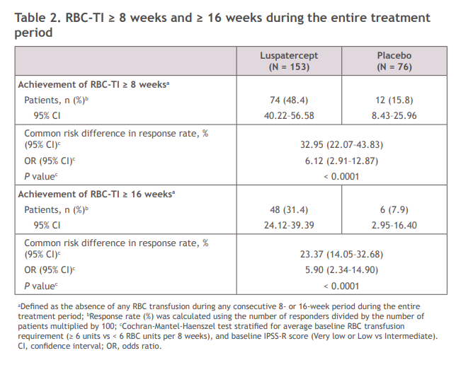
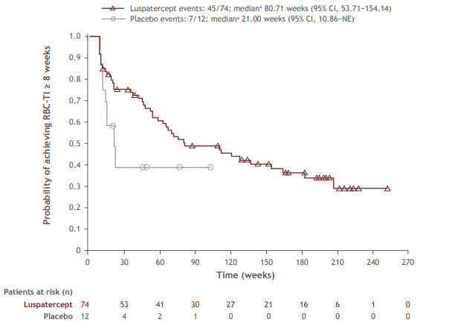
Long-term Utilization and Benefit of Luspatercept in Patients with LR-MDS from the MEDALIST Trial
RBC-TI ≥8 weeks and ≥16 weeks
during the entire treatment period
Cumulative duration of RBC-TI ≥8 weeks
for patients who achieved RBC-TI ≥8 weeks during the entire treatment period
Progression to HR-MDS/AML during the entire treatment period:
Luspatercept: 13 of 153 (8.5%)
Placebo: 5 of 76 (6.6%)
Median time to HR-MDS/AML progression:
Luspatercept: 57.23 months
Placebo: 32.69 months
ªDefined as the absence of any RBC transfusion during any consecutive 8- or 16-week period during the entire treatment period; ^{b}Response rate (%) was calculated using the number of responders divided by the number of patients multiplied by 100;
^{c}Cochran-Mantel-Haenszel test stratified for average baseline RBC transfusion requirement (≥6 units vs <6 RBC units per 8 weeks), and baseline IPSS-R score (Very low or Low vs Intermediate).
Cumulative duration of RBC-TI ≥8 weeks is defined as the sum of all durations of RBC-TI during the entire treatment phase for patients who achieved RBC-TI ≥8 weeks during the entire treatment period.
ªMedian is from unstratified KM method.
Notes:
Fenaux P, Santini V, Komrokji RS, et al. Long-term utilization and benefit of luspatercept in patients (pts) with lower-risk myelodysplastic syndromes (LR-MDS) from the MEDALIST trial. Abstract presented at: EHA2022 Congress; Vienna, Austria; June 9-17, 2022. Poster presentation P778.

Slide 26
2022 ASH Data
MEDALIST Trial OS and PFS
MEDALIST Trial Response by Baseline Transfusion Burden and Dose Level
Luspatercept Real-World Data

Slide 27
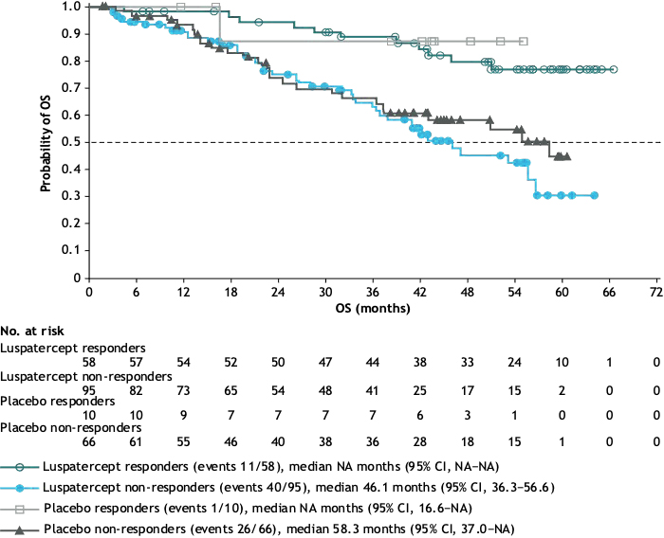
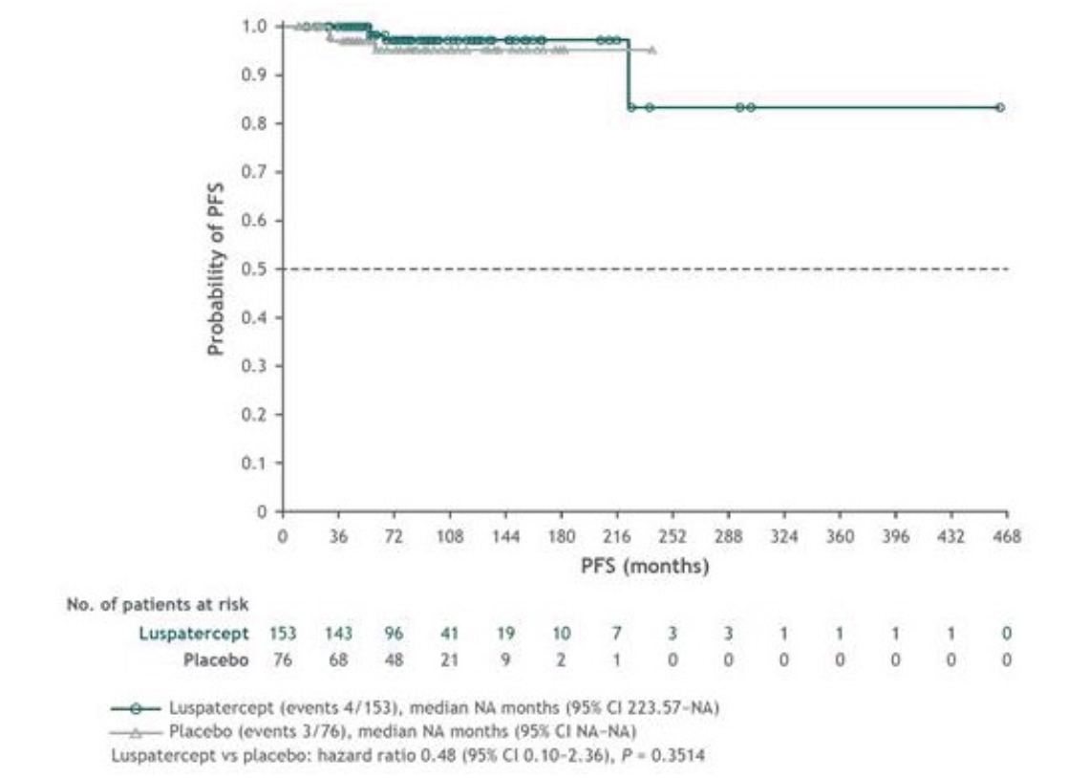
Abstract 1174: OS and PFS with Luspatercept
OS with luspatercept:
Responders vs non-responders in the ITT population
PFS with luspatercept vs placebo
Luspatercept responders vs placebo responders: HR, 1.47 (95% CI, 0.19–11.46); P = 0.7088.
Luspatercept non-responders vs placebo non-responders: HR, 1.28 (95% CI, 0.78–2.10); P = 0.3355.
Luspatercept responders vs luspatercept non-responders: HR, 0.26 (95% CI, 0.13–0.52); P < 0.0001.
Data cut: January 15, 2022. OS was defined as time from randomization to death from any cause. Responders were defined as patients with an absence of any RBC transfusion ≥8 weeks during the first 24 weeks of double-blind treatment.
Notes:
Santini V, Fenaux P, Zeidan AM, et al. Overall survival and progression-free survival of patients following luspatercept treatment in the MEDALIST trial. Blood. 2022;140(Supplement 1):4079–4081.

Slide 28
Abstract 1174 Summary
Luspatercept was associated with increased 36-month OS probability for patients with IPSS-R very LR-MDS vs placebo:
77.8% vs 16.7% (odds ratio 17.5; P = 0.0088)
Luspatercept was associated with increased 36-month PFS probability in patients with a baseline serum EPO level of 100 to ≤200 U/L vs placebo
97.3% vs 78.9% (odds ratio 9.6; P = 0.0238)
Patients with LR-MDS with these baseline characteristics may derive greater survival benefit from luspatercept
Notes:
Santini V, Fenaux P, Zeidan AM, et al. Overall survival and progression-free survival of patients following luspatercept treatment in the MEDALIST trial. Blood. 2022;140(Supplement 1):4079–4081.

Slide 29
Abstract 3098: Transfusion Independence and Response by Dose Level
RBC-TI ≥8 Weeks Response Periods Per Patient by Baseline Transfusion Burden
Responders at Different Luspatercept Dose Levels
Total Number of Responders
22 8 20 3 15 1 6 0 11 0
 | ITT population |  | LTB at baseline |  | ITB at baseline |  | HTB at baseline
 | L (n = 74) | P (n = 12) | L (n = 39) | P (n = 8) | L (n = 20) | P (n = 2) | L (n = 15) | P (n = 2)
Responders at dose level, n (%)
1.0 mg/kg | 55 (74.3) | 9 (75.0) | 37 (94.9) | 7 (87.5) | 12 (60.0) | 1 (50.0) | 6 (40.0) | 1 (50.0)
1.33 mg/kg | 28 (37.8) | 3 (25.0) | 13 (33.3) | 2 (25.0) | 9 (45.0) | 0 | 6 (40.0) | 1 (50.0)
1.75 mg/kg | 31 (41.9) | 3 (25.0) | 14 (35.9) | 1 (12.5) | 10 (50.0) | 1 (50.0) | 7 (46.7) | 1 (50.0)
1/8
3/20
1/6
7/22
4/15
3/11
2/8
4/20
4/15
3/6
Patients (%)
6/22
3/3
1/1
5/8
13/20
8/11
9/22
7/15
2/6
1
2
3
4
≥5
No. of separate responses
LTB: 0 to <4 RBC units/8 wk
ITB: 0 to ≥4 to <6 RBC units/8 wk
HTB: ≥6 RBC units/8 wk
Notes:
Platzbecker U, Santini V, Komrokji RS, et al. Multiple episodes of transfusion independence with luspatercept treatment and the impact of dose escalation in patients with lower-risk myelodysplastic syndromes from the MEDALIST study. Blood. 2022;140(Supplement 1): 6971–6973.

Slide 30
Abstract 3098 Summary
Patients who were low transfusion burden at baseline experienced more periods of RBC-TI response than intermediate and high transfusion burden patients
Low transfusion burden patients were more likely to respond to lower doses of luspatercept, whereas almost half of intermediate and high transfusion burden patients responded to the maximum dose level
Rates of RBC-TI ≥ 8 weeks response at 1.0 mg/kg decreased with increasing baseline transfusion burden
Notes:
Platzbecker U, Santini V, Komrokji RS, et al. Multiple episodes of transfusion independence with luspatercept treatment and the impact of dose escalation in patients with lower-risk myelodysplastic syndromes from the MEDALIST study. Blood. 2022;140(Supplement 1): 6971–6973.

Slide 31
Abstract 1757: Real World Data Replicates MEDALIST Study Results and Confirms Activity Among HMAs and Lenalidomide Treated Patients
Seventy-three pts (67%) had MDS-RS subtype
91% were intermediate- or lower-risk MDS by IPSS-R
SF3B1 mutation (MT) was detected in 71% (80/112). The mean Hgb level was 7.90 g/dl and 47% were RBC HTB transfusion dependent.
The median serum erythropoietin (EPO) level at time of referral was 122 U/L (19% >500 U/L) (n = 77)
Majority had prior erythroid-stimulating agents (ESA) (89%) with 29% hematological response to prior ESA
59 pts (53%) had prior HMA therapy, and 42 patients (47%) had prior lenalidomide
HI correlated with baseline RBC-TB
Almost 55% of pts needed dose escalation:
62 pts received 1.33 mg/kg
63 pts received 1.75 mg, among whom 40% (25 pts) demonstrated response to higher doses
Based on RBC-TB:
75% (6/8) NTD patients achieved HI with highest dose escalation
40% (10/25) LTB pts achieved HI with dose escalation
30% (9/30) HTB pts achieved response with dose escalation
% (n) | RWD (n = 114) | MEDALIST (n = 153)
Overall response Hgb increase >1.5 g/dl in NTD or Hgb increase >1.5 g/dl with RBC-TI in RBC-TD RBC-TI without Hgb 1.5 g/dl increase >50% reduction in RBC-TB | 39.5 (45) 27 (30/113) 5 (6/113) 7 (8/112) | 38 (58)
Response in NTD: Hgb increase more than 1.5 g/dl | 69 (9/13) | NA
Response in LTB Hgb increase more than 1.5 g/dl and RBC-TI RBC-TI without Hgb 1.5 g/dl increase >50% reduction in RBC-TB | 46 (22/47) 34 (16/47) 6 (3/47) 6 (3/47) | 59 (52/87) RBC-TI
Response in HTB Hgb increase more than 1.5 g/dl and RBC-TI RBC-TI without Hgb 1.5 g/dl increase >50% reduction in RBC-TB | 24 (13/53) 9 (5/53) 6(3/53) 9 (5/53) | 9 (6/66) RBC-TI
Notes:
Komrokji RS, Al Ali N, Ball S, et al. Luspatercept for treatment of lower risk myelodysplastic syndromes: real world data replicates medalist study results and confirms activity among hypomethylating agents and lenalidomide treated patient. Blood. 2022;140(Supplement 1):4039–4041.

Slide 32
Abstract 1757 Summary
Real-world data confirms clinical benefit and safety profile of luspatercept observed in the MEDALIST trial
Responses are dose dependent with 1/3 of patients who were dose escalated responding
Low baseline RBC-TB dependency and SF3B1 MT correlated with higher response rates
Luspatercept retained activity after HMA or lenalidomide failure; however, a trend of lower responses was observed correlated with RBC-HTB among those patients
Notes:
Komrokji RS, Al Ali N, Ball S, et al. Luspatercept for treatment of lower risk myelodysplastic syndromes: real world data replicates medalist study results and confirms activity among hypomethylating Aagents and lenalidomide treated patient. Blood. 2022;140(Supplement 1):4039–4041.

Slide 33
Abstract 389: Transfusion Outcomes During Luspatercept Treatment
 | All patients (N = 76)
TB in the 8 weeks prior to luspatercept initiation. n (%) TI Low TB Moderate TB High TB | 1 (1.3) 65 (85.5) 10 (13.2) 0
TB conversion during first 24 weeks of luspatercept treatment, n (%) TI prior to luspatercept initiation Maintained TI Converted to increased TB status Low TB prior to luspatercept initiation Maintained low TB Converted from low TB to TI Converted from low TB to higher TB Moderate TB prior to luspatercept initiation Maintained moderate TB Converted from moderate TB to lower TB Converted from moderate TB to higher TB | 1 (1.3) 1 (100.0) 0 65 (85.5) 5 (7.7) 60 (92.3) 0 10 (13.2) 0 10 (100.0) 0
Notes:
Mukherjee S, Brown-Bickerstaff C, McBride A, et al. Real-world outcomes of patients with lower-risk myelodysplastic syndromes (LR-MDS) treated with luspatercept: an evaluation of US clinical practice utilization and treatment patterns. Blood. 2022;140(Supplement 1):944-946.

Slide 34
Abstract 389 Summary
>90% of patients with low transfusion burden prior to luspatercept initiation achieved TI within the first 24 weeks of luspatercept treatment
All patients with moderate transfusion burden prior to luspatercept had a decrease in level of transfusion burden within the first 24 weeks of starting luspatercept treatment
This study suggests that initiating luspatercept for low or moderate transfusion burden may have a substantial impact on transfusion burden
Notes:
Mukherjee S, Brown-Bickerstaff C, McBride A, et al. Real-world outcomes of patients with lower-risk myelodysplastic syndromes (LR-MDS) treated with luspatercept: an evaluation of US clinical practice utilization and treatment patterns. Blood. 2022;140(Supplement 1):944-946.
Fenaux P, Platzbecker U, Mufti GJ, et al. Luspatercept in patients with lower-risk myelodysplastic syndromes. N Engl J Med. 2020;382(2):140-151.

Slide 35
Activity of Luspatercept and ESAs Combination for Treatment of Anemia in Lower-Risk MDS
Baseline characteristics (n = 28) | % (n)
Age (median) | 72 (51-94)
Gender (male) | 68(19)
Race (white) | 96 (27)
MDS classification WHO 2016 MDS-SLD MDS-MLD MDS-SLD-RS MDS-MLD-RS MDS del 5q MDS/MPN-RS-T | 10.7 (3) 10.7 (3) 32.1 (9) 21.4 (6) 3.6 (1) 21.4 (6)
R-IPSS Very low Low Intermediate High | 21.4 (6) 67.9 (19) 7.1 (2) 3.6 (1)
Hgb (mean) g/dl | 8 (6.6-9.4)
Platelets (mean) x10⁹/L | 259 (16-814)
ANC (mean) x10⁹/L | 2.53 (.45-9.1)
Myeloblasts % (mean) | 2 (0-4)
Serum erythropoietin level (median) U/L | 119.5 (n = 18)
RBC transfusion Burden NTD LTB HTB | 11 (3) 46 (13) 43 (12)
Prior ESA treatment Prior HMA treatment Prior Lenalidomide treatment | 89 (24) 42 (12) 39 (11)
Somatic mutations SF3B1 TET-2 DNMT3A ASXL-1 TP53 JAK-2 | 85.7 (24) 44 (12/27) 22 (6/27) 4 (1/27) 4 (1/27) 12 (3/27)
 | % (n)
Overall response (n = 28) Hgb increase more than 1.5 g/dl in NTD or Hgb increase more than 1.5 g/dl with RBC-TI in RBC-TD RBC-TI without Hgb 1.5 g/dl increase >50% reduction in RBC-TB | 36 (10) 18 (5/28) 14 (4/28) 4 (1/28)
Response in NTD (n = 3) Hgb increase more than 1.5 g/dl | 33 (1/3)
Response in LTB (n = 13) Hgb increase more than 1.5 g/dl and RBC-TI RBC-TI without Hgb 1.5 g/dl increase >50% reduction in RBC-TB | 38 (5/13) 15 (2/13) 23 (3/13) 0
Response in HTB (n = 12) Hgb increase more than 1.5 g/dl and RBC-TI RBC-TI without Hgb 1.5 g/dl increase >50% reduction in RBC-TB | 33 (4/12) 17 (2/12) 8 (1/12) 8 (1/12)
Predictors of response included:
Prior response to luspatercept monotherapy or frontline combination compared to primary luspatercept failure
Endogenous serum erythropoietin levels <500
SF3B1 mutation
HMA/Lenalidomide treatment naïve
Notes:
Komrokji RS, Aguirre LE, Al-Ali N, et al. Activity of luspatercept and ESAs combination for treatment of anemia in lower-risk myelodysplastic syndromes. Blood Adv. Published online April 14, 2023. doi:10.1182/bloodadvances.2023009781

Slide 36
2023 ASCO and EHA Data
COMMANDS Trial Luspatercept
IMerge Trial Imetelstat

Slide 37
COMMANDS Trial: Study Design
Study design: open-label, randomized, phase 3 trial
Inclusion criteria: IPSS-R defined LR-MDS (with or without ≥15% RS) who have NOT received ESA, and who require regular RBC transfusions (defined as an average transfusion requirement of 2-6 RBC units/8 weeks for ≥8 weeks immediately prior to randomization)
Primary endpoint: RBC-TI for ≥12 weeks (Week 1 through Week 24), with a concurrent mean Hb increase of ≥1.5 g/dL compared with baseline
Key Eligibility Criteria
≥ 18 years of age
IPSS-R very low-, low, or intermediate-risk MDS (with or without RS) by WHO 2016, with < 5% blasts in bone marrow
Required RBC transfusions (2–6 pRBC units/8 weeks for a minimum of 8 weeks immediately prior to randomization)
Endogenous sEPO < 500 U/L
ESA-naive
Patients stratified by:
Baseline sEPO level
Baseline RBC transfusion burden
RS status
Response assessment at day 169 and every 24 weeks thereafter
Post-treatment safety follow-up
Monitoring for other malignancies, HR-MDS or AML progression, subsequent therapies, survival
For 5 years from first dose or 3 years from last dose, whichever is later
Luspatercept
(N = 178) 1.0 mg/kg s.c. Q3W;
titration up to 1.75 mg/kg
Randomization 1:1
Epoetin alfa
(N = 178)
450 IU/kg s.c. QW;
titration up to 1,050 IU/kg
End of treatment
Due to lack of clinical benefit or disease progression per IWG criteria
.
Notes:
Della Porta M, Platzbecker U, Santini V, et al. The Commands Trial: A Phase 3 Study of the Efficacy and Safety of Luspatercept Versus Epoetin Alfa for the Treatment of Anemia Due to IPSS-R Very Low-, Low-, or Intermediate-Risk MDS in Erythropoiesis Stimulating Agent-Naive Patients Who Require RBC Transfusions. Blood 2020;136(Supplement 1):1-2.
Garcia-Manero G, Platzbecker U, Santini V, et al. Efficacy and safety results from the COMMANDS trial: A phase 3 study evaluating luspatercept vs epoetin alfa in erythropoiesis-stimulating agent (ESA)‑naive transfusion-dependent (TD) patients (pts) with lower‑risk myelodysplastic syndromes (LR-MDS). J Clin Oncol. 2023;41(16 suppl):7003.
Della Porta M, Platzbecker U, Santini V, et al. Luspatercept versus epoetin alfa for treatment of anemia in ESA-naive lower-risk myelodysplastic syndromes patients requiring RBC transfusions: data from the phase 3 COMMANDS study. Abstract presented at: EHA2023 Hybrid Congress; Frankfurt, Germany; June 8-11, 2023. Abstract S102.

Slide 38
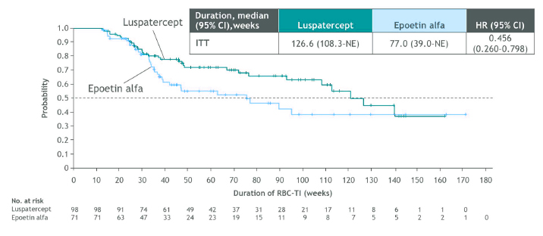
COMMANDS Trial: Primary Endpoint Luspatercept Superior to Epoetin Alfa
Achievement of primary endpoint in different patient subgroups
Duration of RBC-TI ≥ 12 weeks longer with luspatercept
Notes:
Garcia-Manero G, Platzbecker U, Santini V, et al. Efficacy and safety results from the COMMANDS trial: A phase 3 study evaluating luspatercept vs epoetin alfa in erythropoiesis-stimulating agent (ESA)‑naive transfusion-dependent (TD) patients (pts) with lower‑risk myelodysplastic syndromes (LR-MDS). J Clin Oncol. 2023;41(16 suppl):7003.
Della Porta M, Platzbecker U, Santini V, et al. Luspatercept versus epoetin alfa for treatment of anemia in ESA-naive lower-risk myelodysplastic syndromes patients requiring RBC transfusions: data from the phase 3 COMMANDS study. Abstract presented at: EHA2023 Hybrid Congress; Frankfurt, Germany; June 8-11, 2023. Abstract S102.

Slide 39
COMMANDS Trial Summary
COMMANDS study achieved its primary endpoint, demonstrating that luspatercept is superior to ESA in ESA-naive transfusion-dependent LR-MDS
Primary endpoint: 59% of patients treated with luspatercept vs 31% with ESA
Median duration of response: 127 weeks with luspatercept vs 77 weeks with ESA; ~1 year longer than ESAs
Luspatercept provides clinical benefit regardless of subgroups and baseline mutational burden
Luspatercept has a manageable and predictable safety profile, consistent with previous clinical experience and convenient (Q3W) administration
Luspatercept is the first and only therapy to demonstrate superiority in a head-to-head study against ESAs and brings a paradigm shift in the treatment of LR-MDS-associated anemia
Notes:
Garcia-Manero G, Platzbecker U, Santini V, et al. Efficacy and safety results from the COMMANDS trial: A phase 3 study evaluating luspatercept vs epoetin alfa in erythropoiesis-stimulating agent (ESA)‑naive transfusion-dependent (TD) patients (pts) with lower‑risk myelodysplastic syndromes (LR-MDS). J Clin Oncol. 2023;41(16 suppl):7003.
Della Porta M, Platzbecker U, Santini V, et al. Luspatercept versus epoetin alfa for treatment of anemia in ESA-naive lower-risk myelodysplastic syndromes patients requiring RBC transfusions: data from the phase 3 COMMANDS study. Abstract presented at: EHA2023 Hybrid Congress; Frankfurt, Germany; June 8-11, 2023.Abstract S102.

Slide 40
IMerge Trial: Study Design
Phase 3
Double-blind, randomized
118 Clinical sites in 17 countries
Imetelstat
7.5 mg/kg IV/4 weeks
(N = 118)
Primary endpoint:
8-week RBC-TI
Key secondary endpoints:
24-week RBC-TI
Duration of TI
Hematologic improvement-erythroid
Safety
Key exploratory endpoints:
VAF changes
Cytogenetic response
PRO: fatigue measured by FACIT-Fatigue
Patient Population (ITT N = 178)
IPSS low- or intermediate-1–risk MDS
Relapsed/refractory to ESA or EPO >500 mU/mL (ESA ineligible)
Transfusion dependent: ≥4 units RBCs/8 weeks over 16-week pre-study
Non-deletion 5q
No prior treatment with lenalidomide or HMAs
Stratification:
Transfusion burden (4-6 vs >6 units)
IPSS risk category (low vs Intermediate 1)
R 2:1
Supportive care, including RBC and platelet transfusions, myeloid growth factors (e.g., G-CSF), and iron chelation therapy administered as needed on study per investigator discretion
Placebo
(N = 60)
Safety population (treated) N = 177
Imetelstat N = 118
Placebo N = 59
EPO, erythropoietin; ESA, erythropoiesis stimulating agent; FACIT-Fatigue, Functional Assessment of Chronic Illness Therapy – Fatigue Scale; G-CSF, granulocyte colony-stimulating factor; Hgb, hemoglobin; HMA, hypomethylating agent; IPSS, International Prognostic Scoring System; ITT, intent-to-treat; IV, intravenous; MDS, myelodysplastic syndromes; R, randomization; RBC, red blood cell; TI, transfusion independence, VAF, variant allele frequency.
Platzbecker U, et al. EHA2023 Hybrid Congress. Abstract S165.
Notes:
Platzbecker U, Santini V, Fenauz P, et al. CONTINUOUS TRANSFUSION INDEPENDENCE WITH IMETELSTAT IN HEAVILY TRANSFUSED NON-DEL(5Q) LOWER-RISK MYELODYSPLASTIC SYNDROMES RELAPSED/REFRACTORY TO ERYTHROPOIESIS STIMULATING AGENTS IN IMERGE PHASE 3. Abstract presented at: EHA2023 Hybrid Congress; Frankfurt, Germany; June 8-11, 2023. Abstract S165.

Slide 41
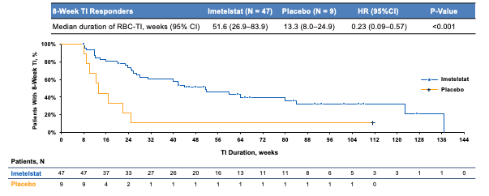
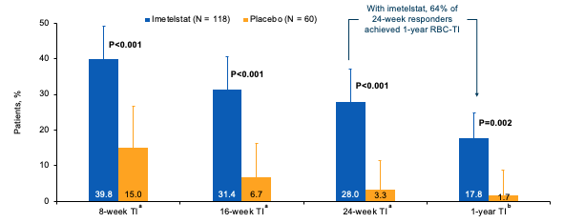
IMerge Trial: Primary Endpoint Imetelstat Superior to Placebo
Higher Rates of Longer-Term Duration of RBC TI Observed With Imetelstat vs Placebo, Including 1-Year RBC TI With Additional 3 Month Follow-up
Imetelstat 8-Week RBC-TI Responders Have Significantly Longer Duration of Transfusion Independence vs Placebo
Significant and Sustained Increase in Hemoglobin Among Patients Treated With Imetelstat
8-Week TI Responders | Imetelstat (N = 47) | Placebo (N = 9)
Median Hgb rise, g/dL (range) | 3.6 (−0.1 to 13.8) | 0.8 (−0.2 to 1.7)
Median Hgb peak, g/dL (range) | 11.3 (8.0–21.9) | 8.9 (7.9–9.7)
ªData cutoff: October 13, 2022. ^{b}Data cutoff: January 13, 2023. RBC, red blood cell; TI, transfusion independence.
Platzbecker U, et al. EHA2023 Hybrid Congress. Abstract S165.
Notes:
Platzbecker U, Santini V, Fenauz P, et al. CONTINUOUS TRANSFUSION INDEPENDENCE WITH IMETELSTAT IN HEAVILY TRANSFUSED NON-DEL(5Q) LOWER-RISK MYELODYSPLASTIC SYNDROMES RELAPSED/REFRACTORY TO ERYTHROPOIESIS STIMULATING AGENTS IN IMERGE PHASE 3. Abstract presented at: EHA2023 Hybrid Congress; Frankfurt, Germany; June 8-11, 2023. Abstract S165.

Slide 42
Higher Cytogenetic Response Rate Per IWG 2006 Criteria With Imetelstat vs Placebo
Cytogenetic Response | Imetelstat (N = 118) | Placebo (N = 60)
Patients with baseline cytogenetic abnormality based on central laboratory review, n (%) | 26 (22) | 13 (22)
Cytogenetic best response, n (%)
Cytogenetic CR | 5 (19) | 1 (8)
Cytogenetic PR | 4 (15) | 1 (8)
Cytogenetic CR or PR criteria not met | 5 (19) | 5 (39)
Not evaluable | 12 (46) | 6 (46)
Cytogenetic CR or PR, n (%) 95% CI | 9 (35) 17-56 | 2 (15) 2-45
% Difference (95% CI) P value | 19 (-16 to 44) 0.216
Complete or partial cytogenetic responses were observed in 9 patients (35%) in the imetelstat group and 2 patients (15%) in the placebo group
Among cytogenetic responders, 6/9 patients (67%) in the imetelstat group also achieved 24-week RBC-TI, none in the placebo group
CR, complete response; IWG, International Working Group; PR, partial response; RBC, red blood cell; TI, transfusion independence.
Santini V, et al. EHA2023 Hybrid Congress. Abstract S164.
Notes:
Santini V, Platzbecker U, Fenaux P, et al. DISEASE-MODIFYING ACTIVITY OF IMETELSTAT IN PATIENTS WITH HEAVILY TRANSFUSED NON-DEL(5Q) LOWER-RISK MYELODYSPLASTIC SYNDROMES RELAPSED/REFRACTORY TO ERYTHROPOIESIS-STIMULATING AGENTS IN IMERGE PHASE 3. Abstract presented at: EHA2023 Hybrid Congress; Frankfurt, Germany; June 8-11, 2023. Abstract S164.

Slide 43
IMerge Trial Summary
Imetelstat treatment provides significant clinical benefit to a heavily TD LR-MDS patient population in need of novel therapy
Treatment with imetelstat vs placebo led to:
Statistically significant and clinically meaningful efficacy with robust 8-week, 24-week, and 1-year TI rates and durable continuous TI
Almost one fifth of imetelstat-treated patients achieved continuous TI for ≥1 year, representing substantial relief from transfusion-associated complications
Higher cytogenetic response rate, which was associated with 8-week RBC-TI
Higher percentage of patients achieving ≥50% reduction in bone marrow RS cells (41% vs 10%)
Sustained reduction of SF3B1 VAF over time
Greater reduction of VAF in multiple genes, which correlated with clinical end points of TI response, longer RBC-TI duration, and increase in Hgb levels
Safety results were consistent with prior reports
VAF reduction and its correlation to clinical endpoints, including durable TI, support imetelstat’s disease-modifying potential
Imetelstat may alter the underlying biology of LR-MDS and can potentially modify the disease by reducing or eliminating malignant clones and improving ineffective erythropoiesis
RBC, red blood cell; RS, ring sideroblasts; TD, transfusion-dependent; TI, transfusion independence; VAF, variant allele frequency.
Platzbecker U, et al. EHA2023 Hybrid Congress. Abstract S165. Santini V, et al. EHA2023 Hybrid Congress. Abstract S164.
Notes:
Platzbecker U, Santini V, Fenauz P, et al. CONTINUOUS TRANSFUSION INDEPENDENCE WITH IMETELSTAT IN HEAVILY TRANSFUSED NON-DEL(5Q) LOWER-RISK MYELODYSPLASTIC SYNDROMES RELAPSED/REFRACTORY TO ERYTHROPOIESIS STIMULATING AGENTS IN IMERGE PHASE 3. Abstract presented at: EHA2023 Hybrid Congress; Frankfurt, Germany; June 8-11, 2023. Abstract S165.
Santini V, Platzbecker U, Fenaux P, et al. DISEASE-MODIFYING ACTIVITY OF IMETELSTAT IN PATIENTS WITH HEAVILY TRANSFUSED NON-DEL(5Q) LOWER-RISK MYELODYSPLASTIC SYNDROMES RELAPSED/REFRACTORY TO ERYTHROPOIESIS-STIMULATING AGENTS IN IMERGE PHASE 3. Abstract presented at: EHA2023 Hybrid Congress; Frankfurt, Germany; June 8-11, 2023. Abstract S164.

